Slide 1
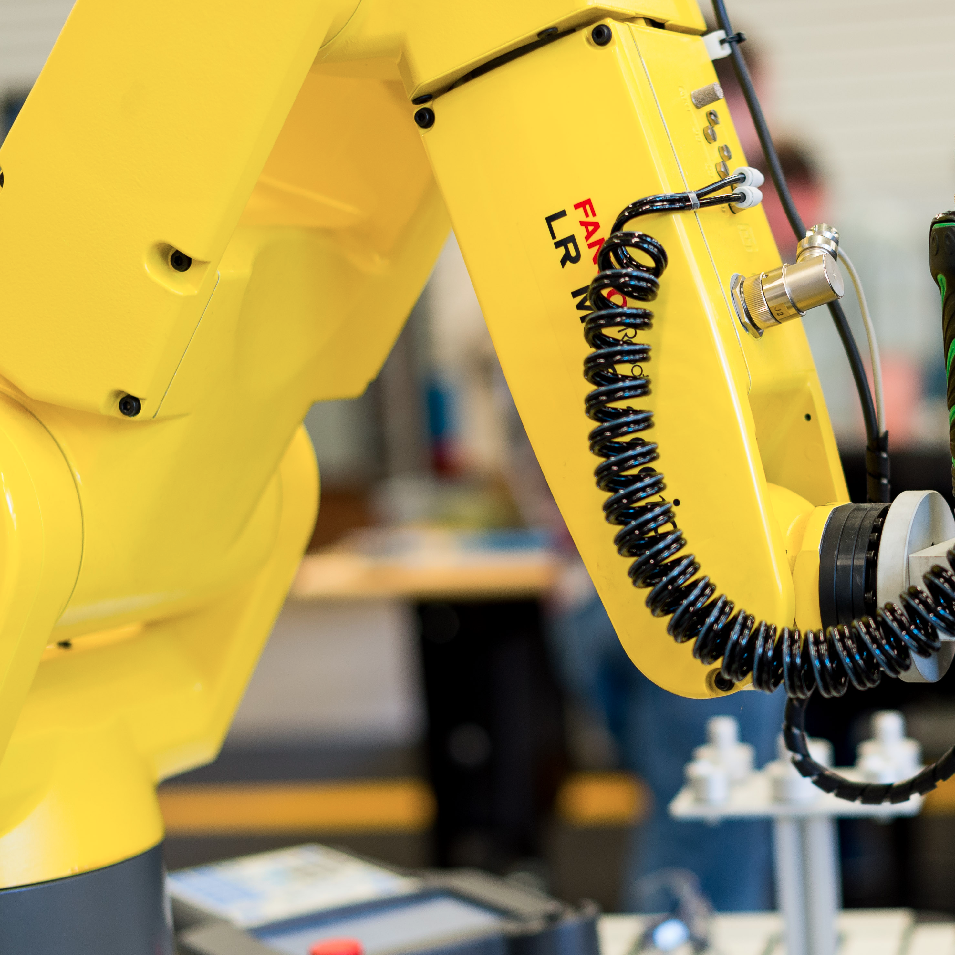
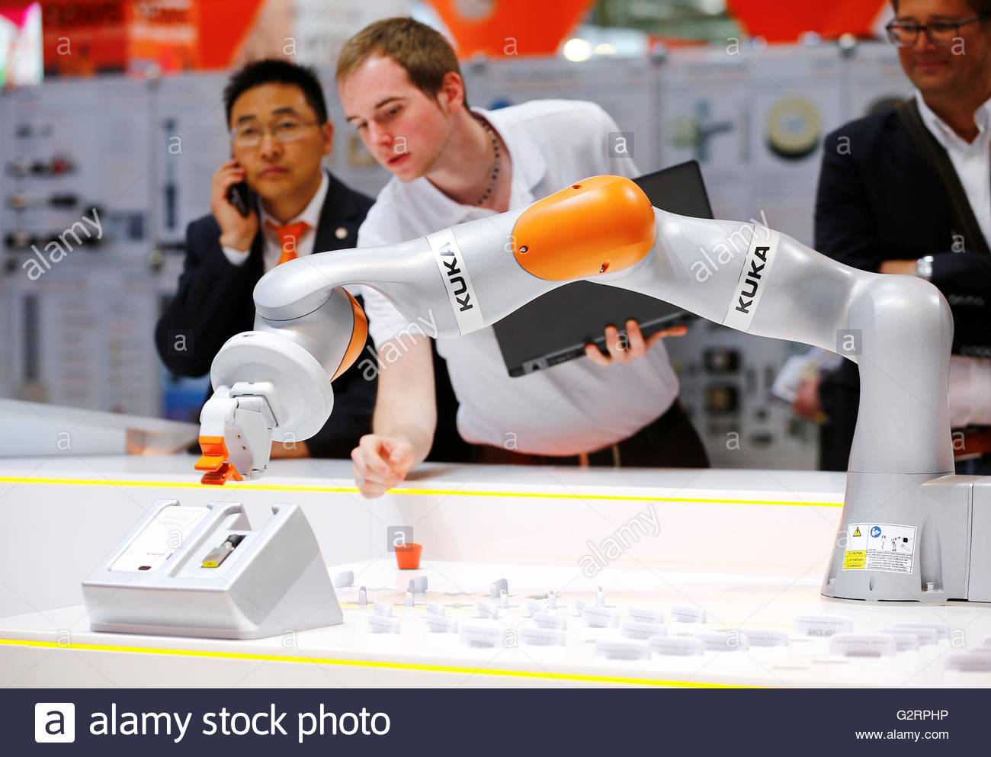
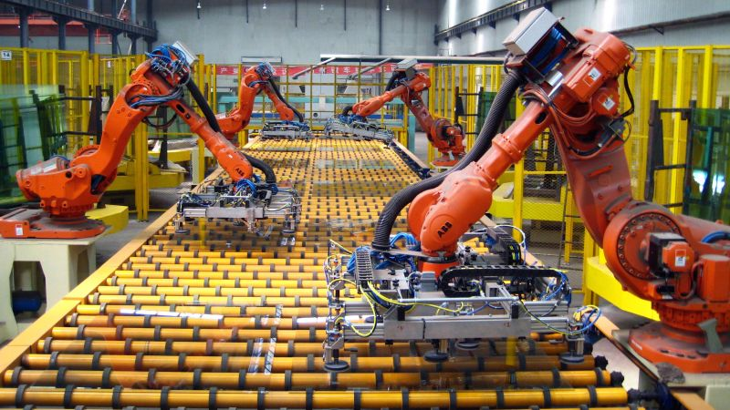
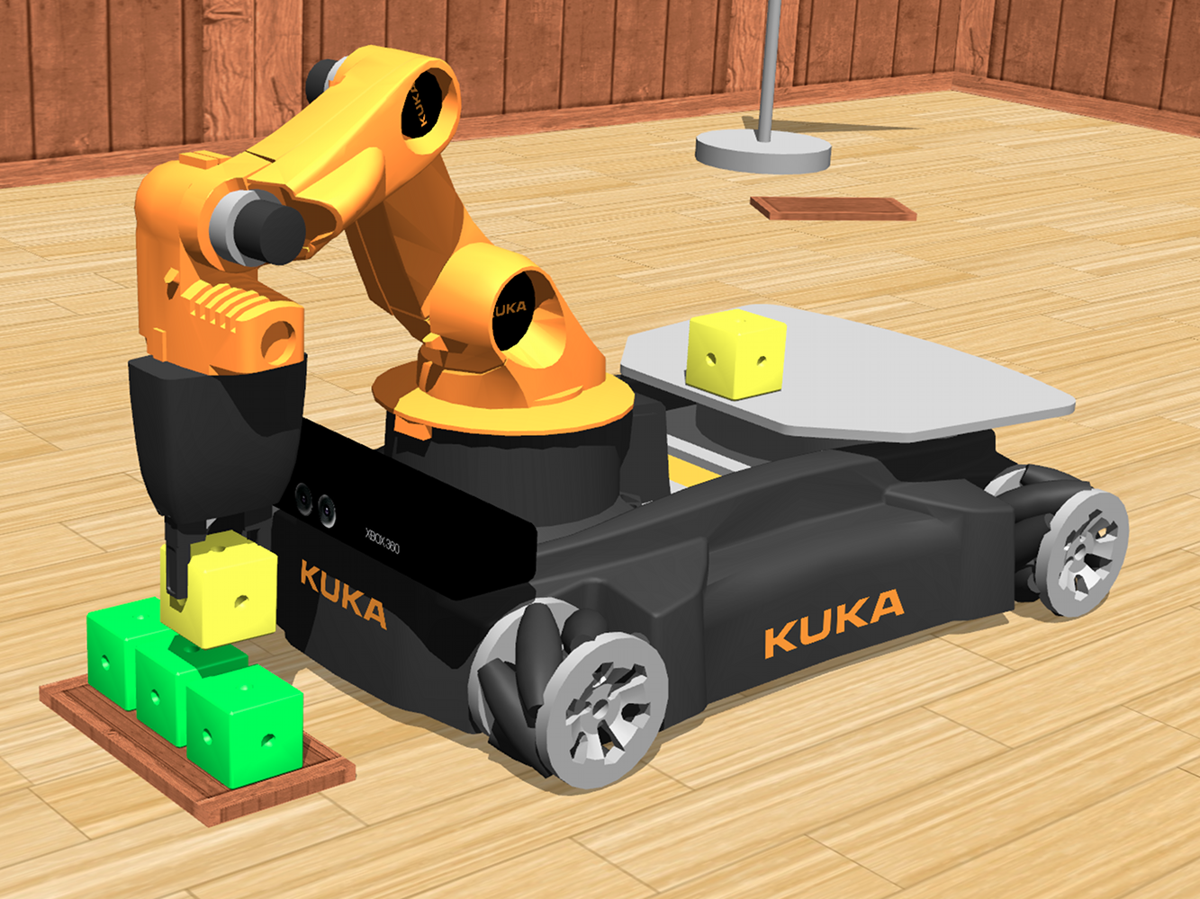
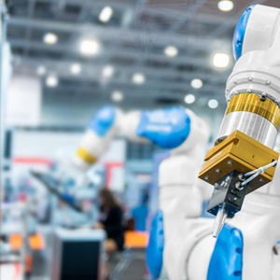
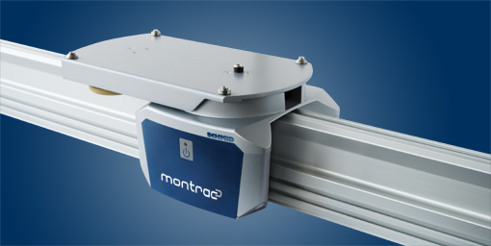


^{Final} ^{Project}
Simulation and Control of a Robotic Production System

Slide 2
Summary
Context
Objectives
System Description & Previous Work
Working Process
Our solution
Limitations
Conclusion

Slide 3
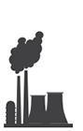
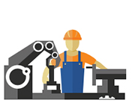
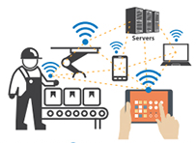
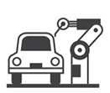
Context
18th century
19th century
20th century
Today
Industry 1.0
Industry 2.0
Industry 3.0
Industry 4.0
Mechanical production.
Equipment powered by steam and water.
Mass production assembly lines requiring labor and electrical energy
Automated production using electronics and IT
Intelligent production incorporated with IoT, cloud technology and Big Data

Slide 4
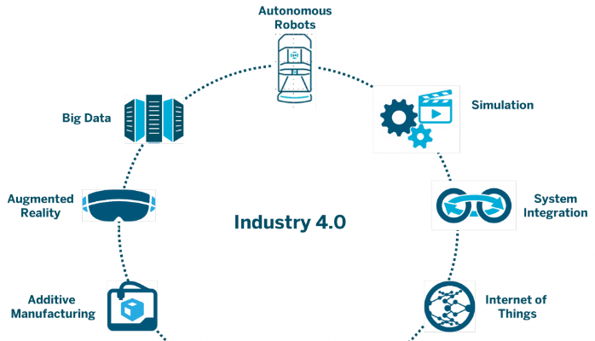



Context
Autonomous Robots
Simulation
Industry 4.0
The factory of
the future
Additive Manufacturing
System Integration

Slide 5
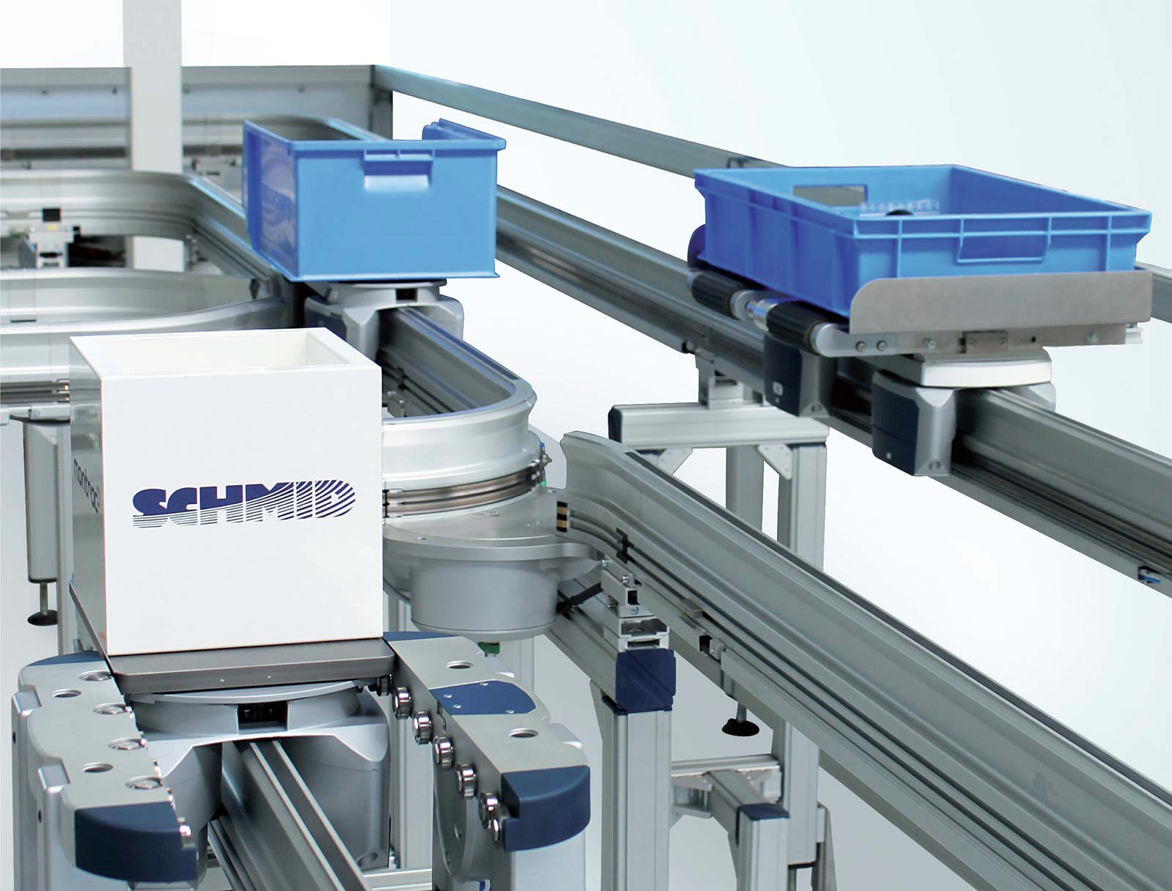
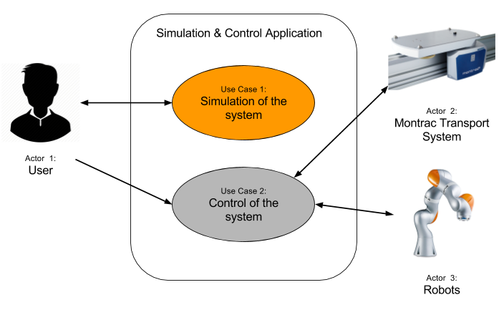

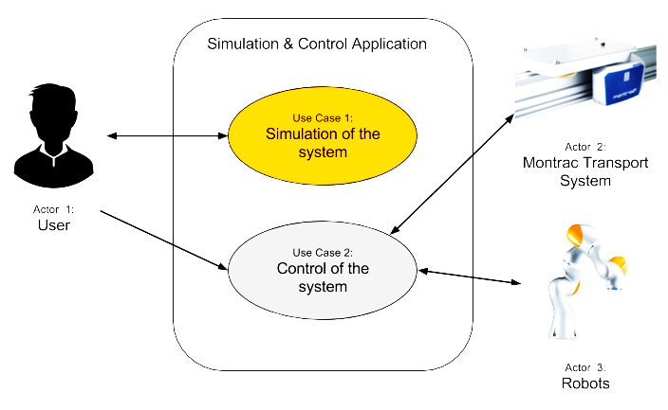
Objectives
Creation of a simulation software for educational purposes
Notes:
Aurelie

Slide 6
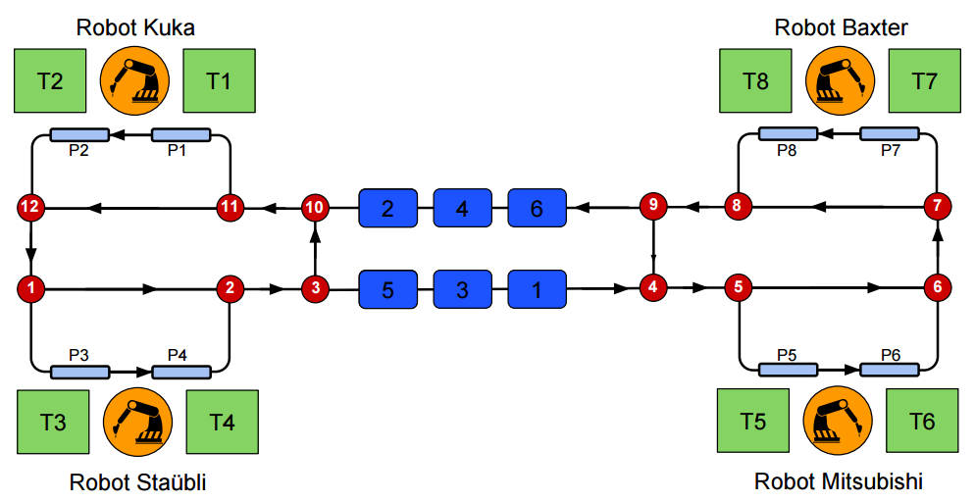
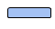
System Description
WS2
WS1
WS8
WS7
Animation…
Rails
Shuttles
Capteurs
Stations
Aiguillages
Robot
Workstation
WS3
WS4
WS5
WS6
Robot
Tasks
Track switch
Shuttles’ initial position
Load/unload zone
Notes:
Claire

Slide 7
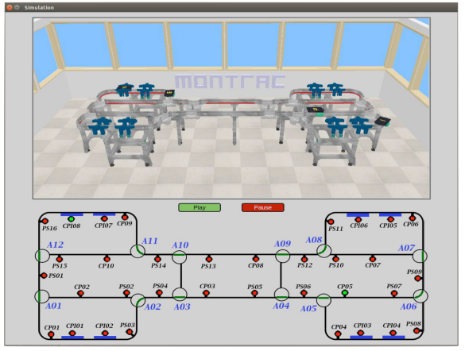
Previous Work
Student Project (UPS)
PLC programming for the real system
Final Project 2016 (N7)
Simulation
Internship (AIP)
Baxter robot interaction
Robot
Tasks
Track switch
Shuttles’ initial position
Load/unload zone
Notes:
Claire

Slide 8



Working Process
Agile Method
Software
Set objectives weekly.
Sprints: Week meetings with teachers.
Continuous delivery of valuable software.
Notes:
Maxime

Slide 9





The world
master
Publication
Callback
Node
Publisher
Topic
Node
Subscriber
Notes:
Maxime

Slide 10
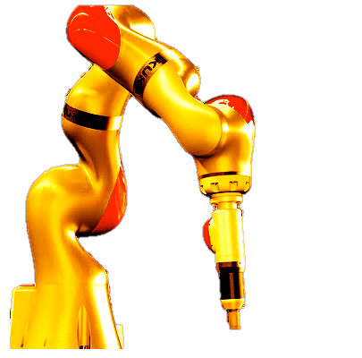
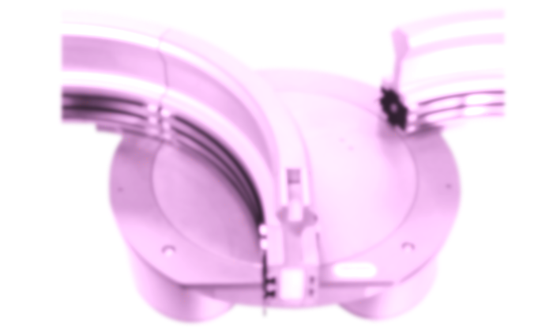
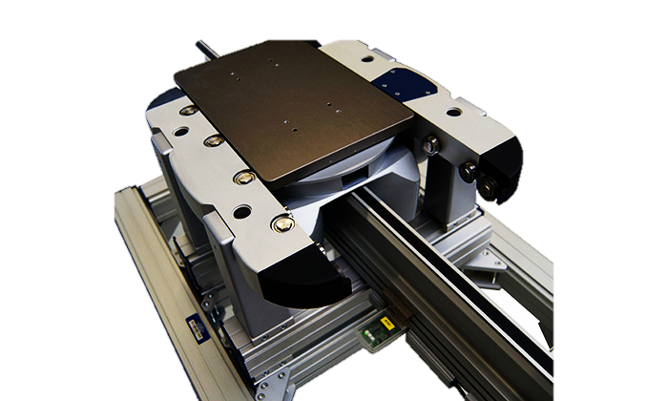
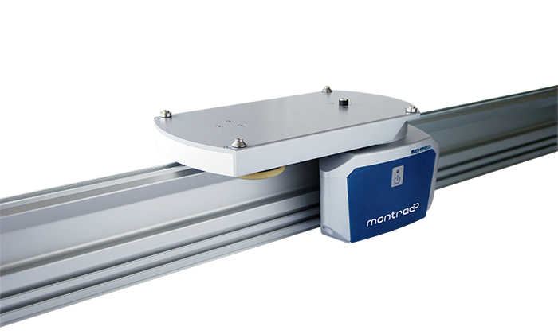
Object-Oriented Approach
Track switch
Station
Shuttles
Robot
Distributed programming
Notes:
Maxime

Slide 11
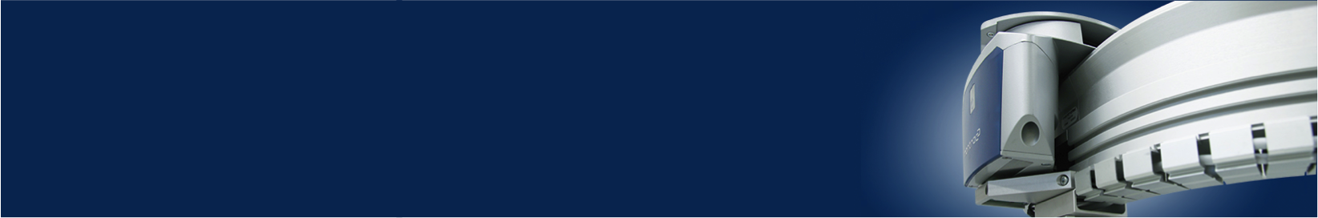
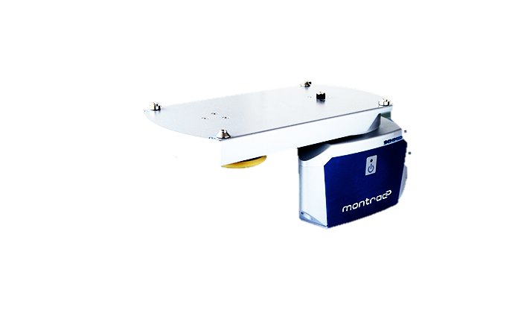
Shuttles
Centralized node with the shuttles’ information.
Communication with several nodes.
Delivers high level services
Main attributes: ID and destination
Delete Shuttles
Shuttles Node
New Product
New Destination
Get Shuttles Info.
New Shuttle
Notes:
Maxime

Slide 12

Track Switch
One node for each track switch.
ID shuttle communication between track switches.
Direction of the shuttles according to their destination.
1In-2Out
2In-1Out
Notes:
JB

Slide 13
Track Switch
Special difficulty for the 3rd and 10th track switches.
One node
Two nodes
3
3
10
10
2In-2Out
No sensor between them
Notes:
JB

Slide 14
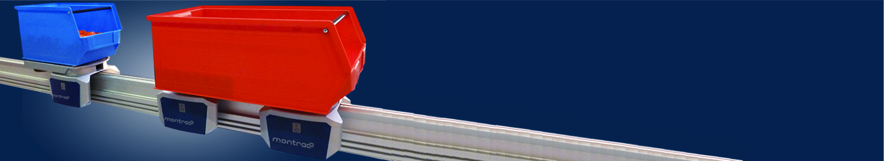
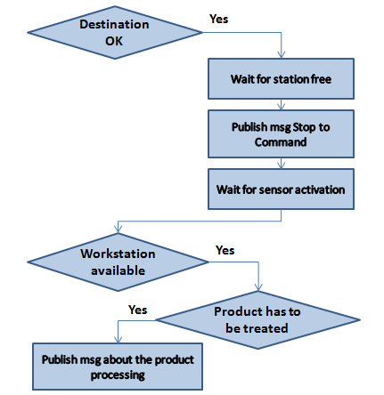
Production Station
One node per production station.
Stopping and setting in motion of the shuttles.
Arriving shuttle
Notes:
JB

Slide 15
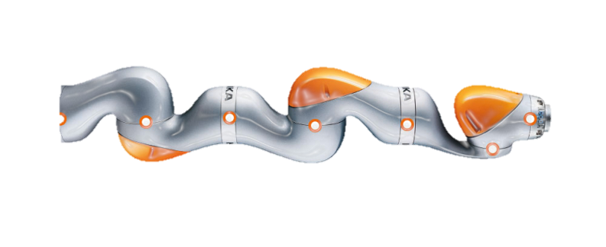
Robots
One node for each robot to avoid blocking scenarios.
Simulation: Replication of robot Kuka LBR IIWA.
Difficulties for grabbing objects.
Solution: Color code.
Notes:
Céline

Slide 16




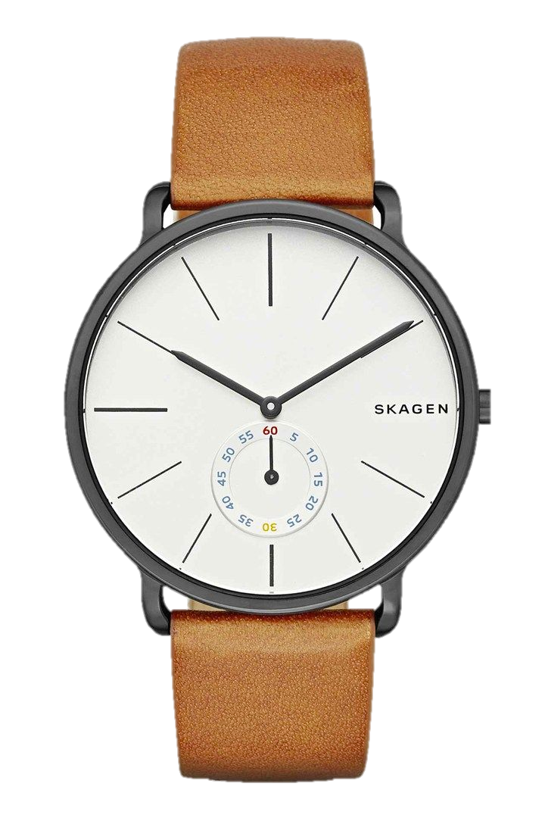
Integration
Simulation control
Scheduling
Main control
Simulation
(x12)
(x8)
(x4)
Notes:
Céline

Slide 17



Scheduling
Automation of the dispatching of the shuttles.
Setup of the supply chain by the user.
Product’s manufacturing lead time calculation.
Configuration File
Log File
Notes:
Céline

Slide 18
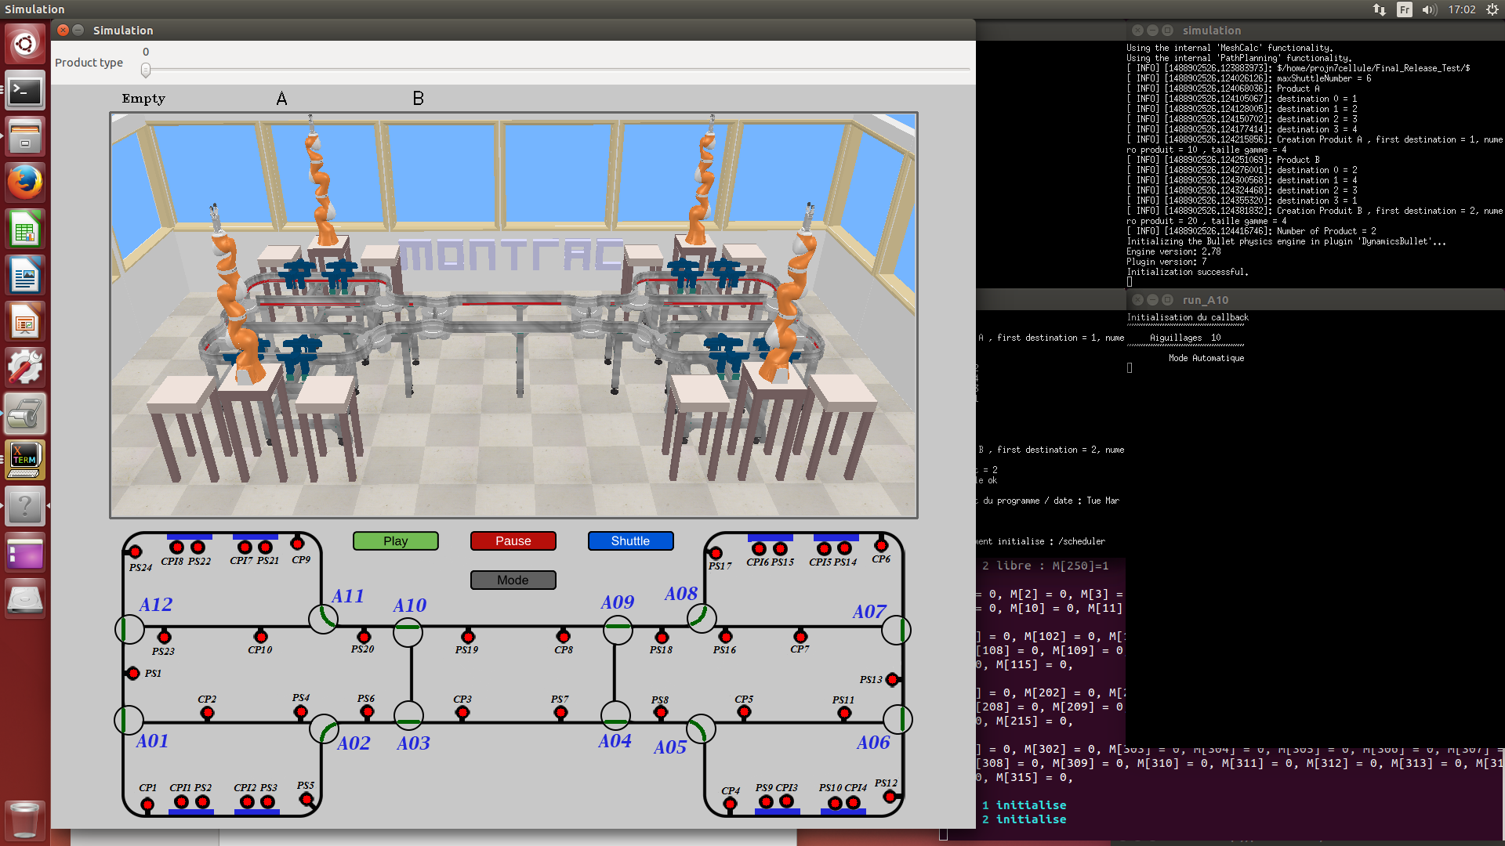

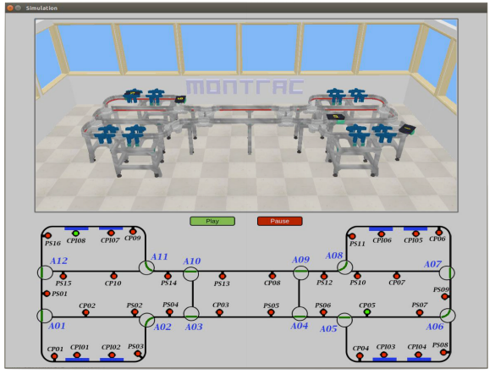
Before
vs. After
After
Notes:
Céline

Slide 19
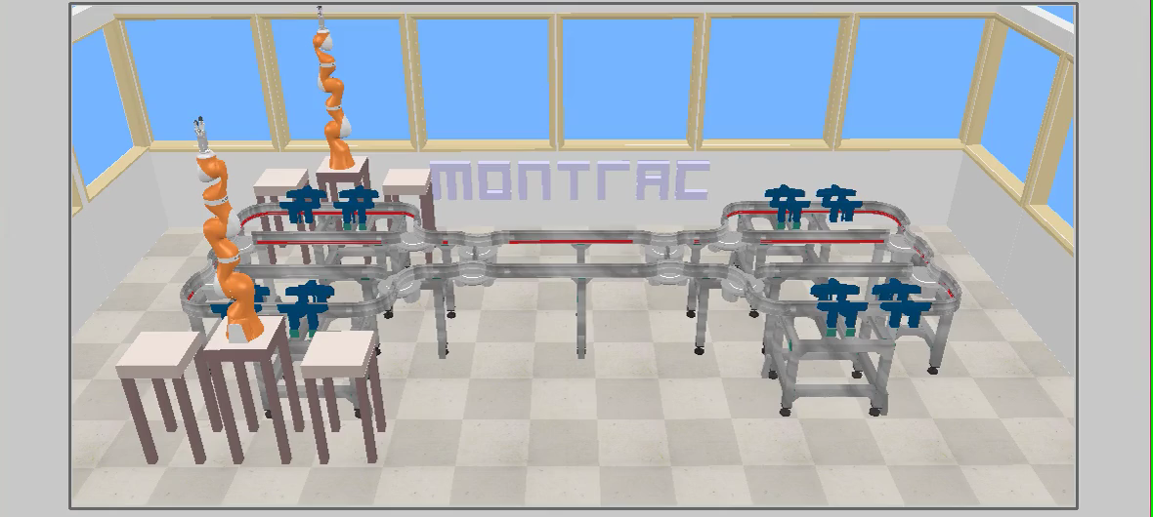


The Final Solution
2
1
Product A
(1 – 2)
3
4
Product B
(2 – 4)
Notes:
Kike

Slide 20
Limitations
Simulation computing time (V-Rep)
Number of shuttles
Compatibility robots-ROS
No connection to the real system
Notes:
Kike

Slide 21
Conclusion
Functional simulation for ENSEEIHT students
Possibility of programming the cell
Future improvements:
Simulation speed
Right side of the simulation
Real system integration
Soft skills improvement
Notes:
Kike

Slide 22
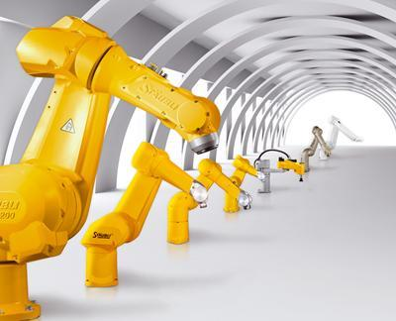
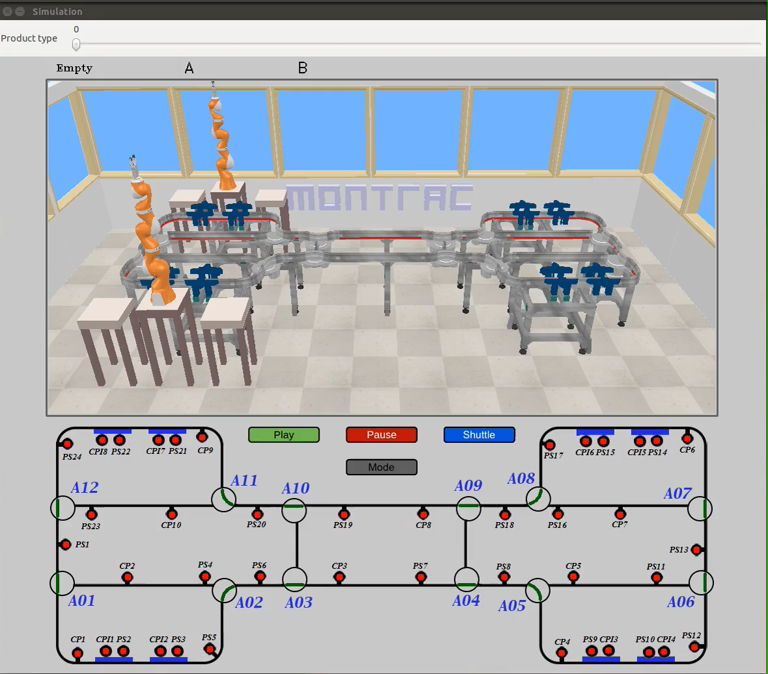
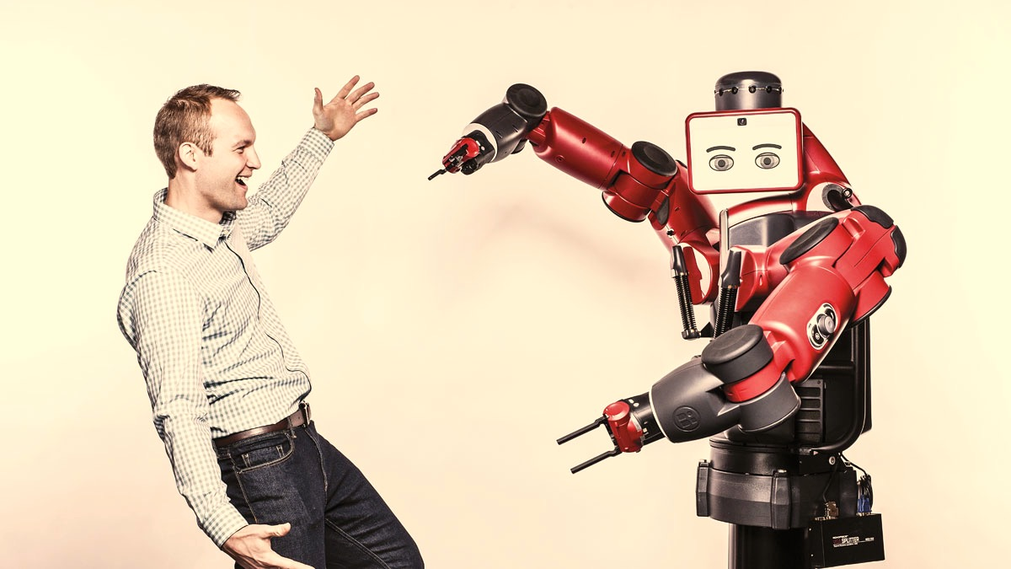
^{Thank you for your attention!}
Feel free to ask any question. We will be more than happy to answer them.

Slide 23
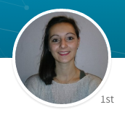
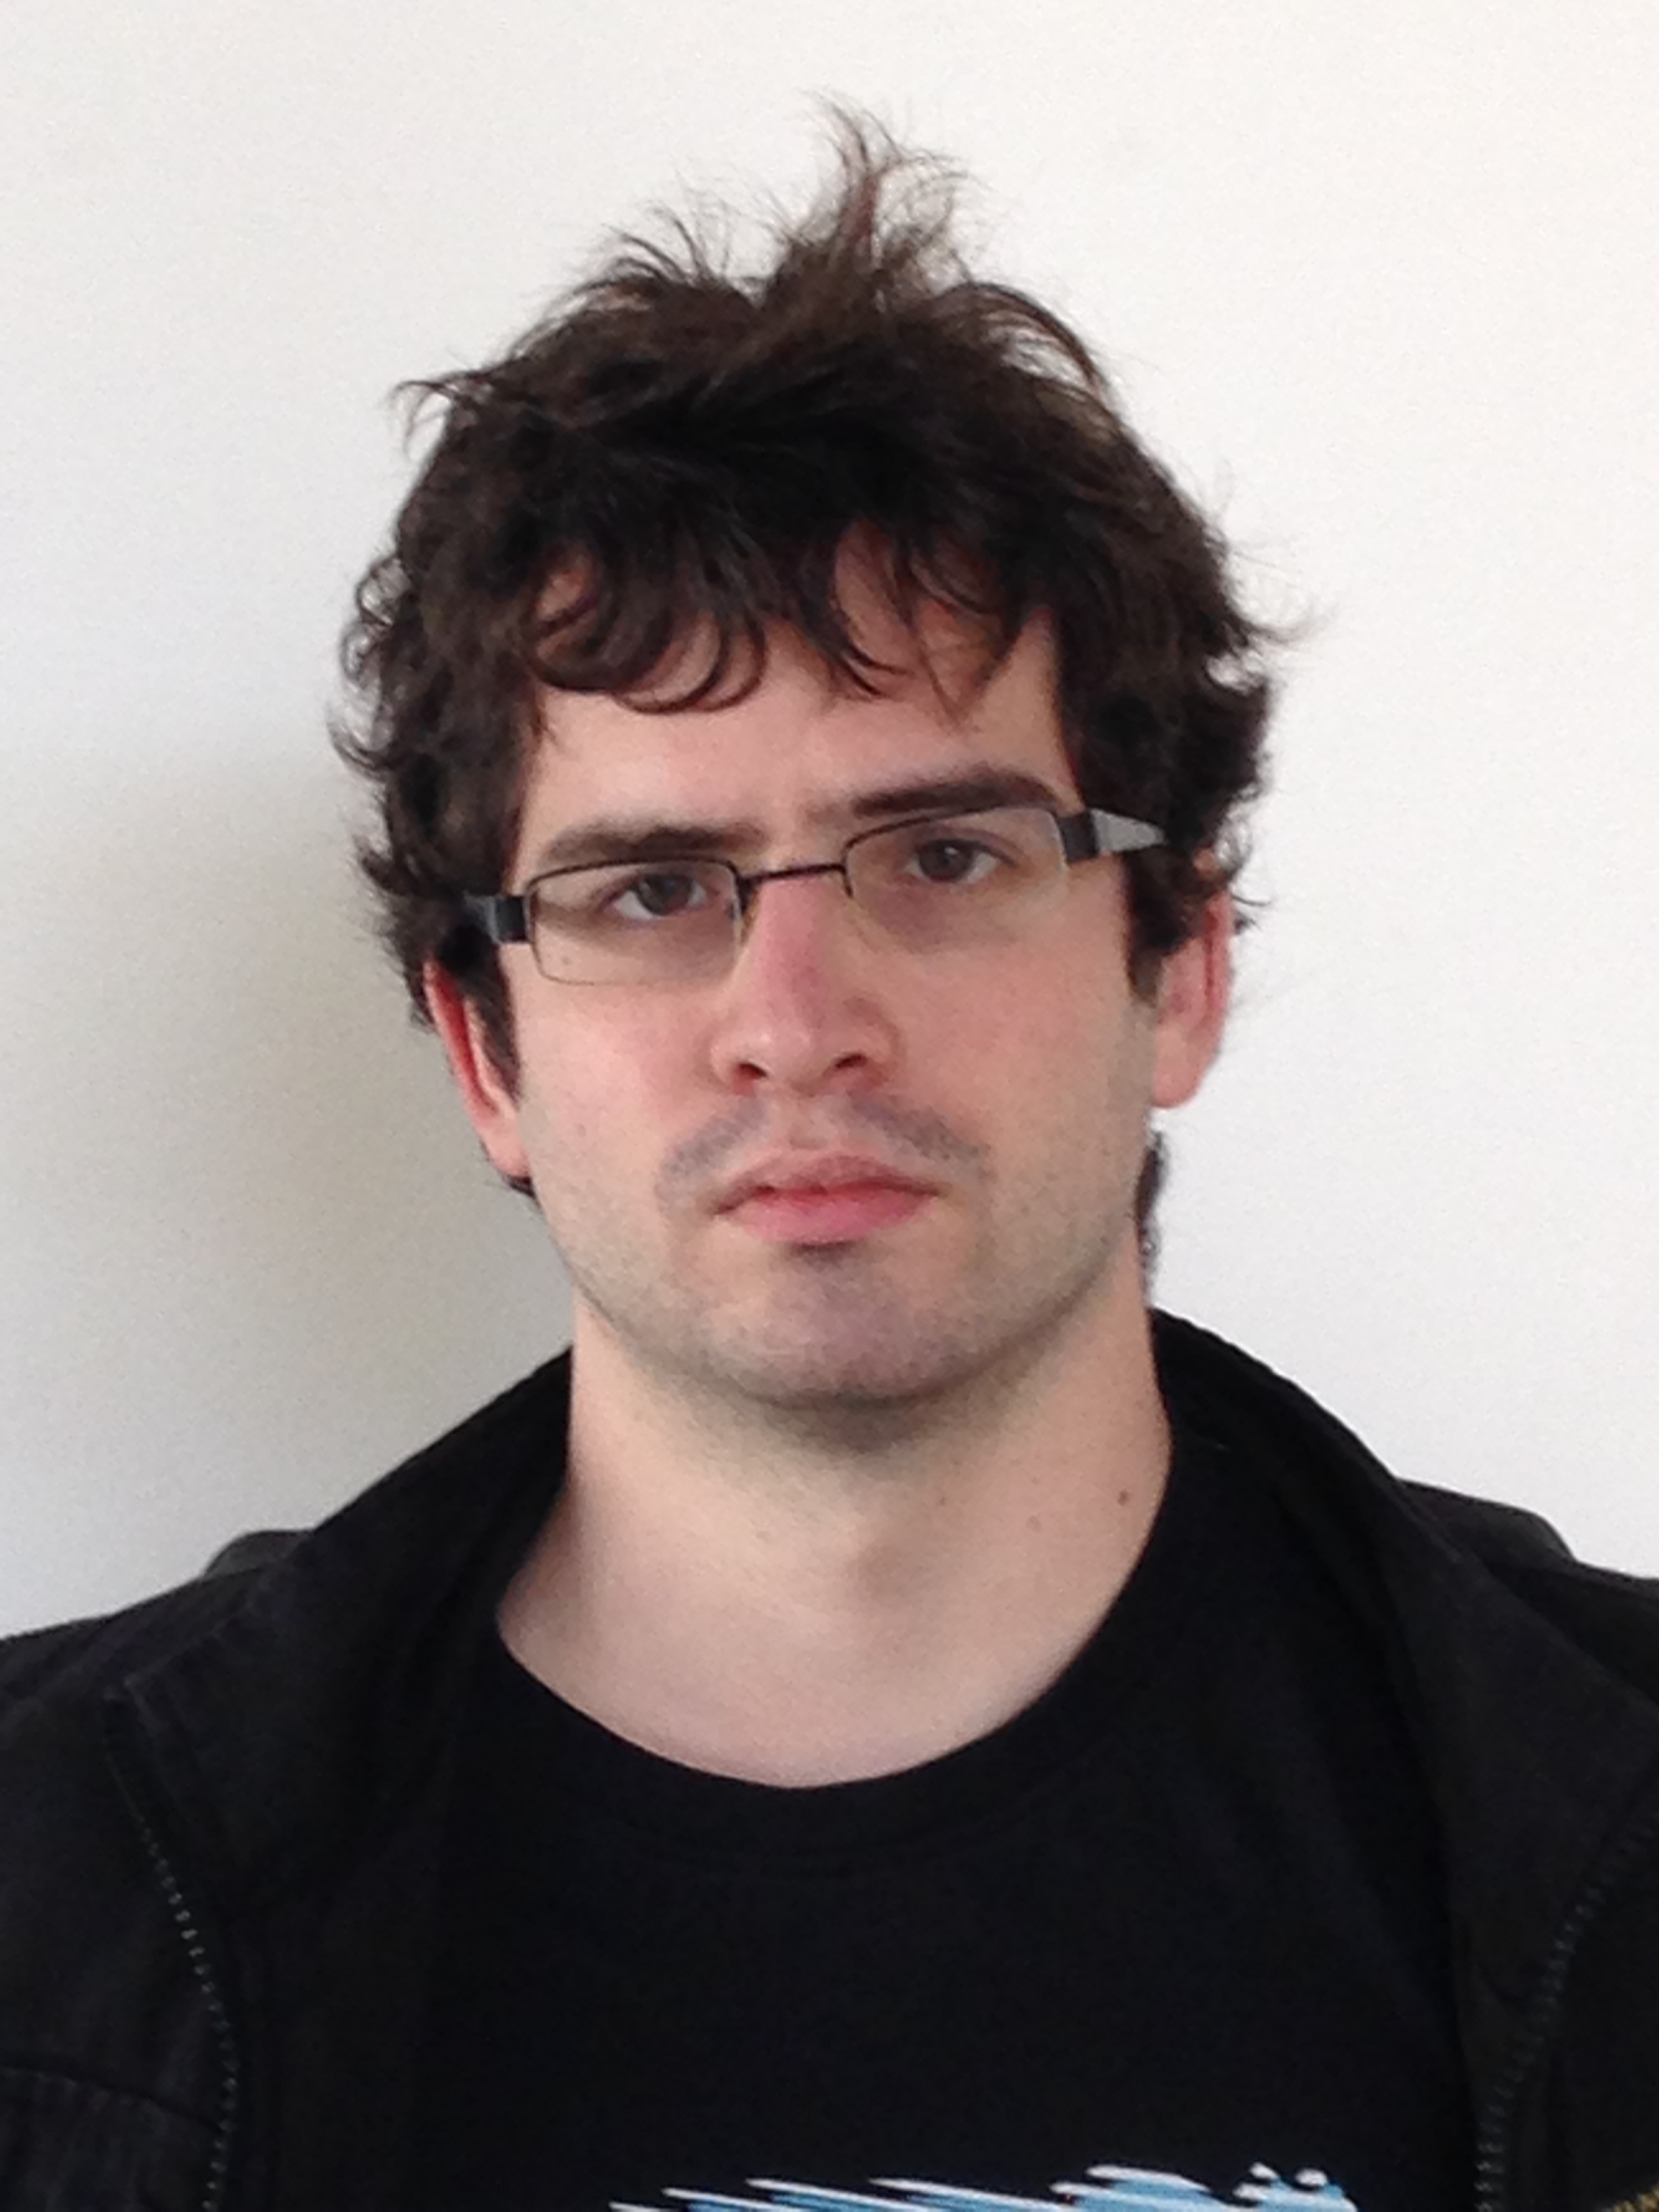
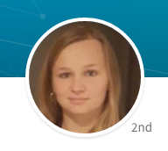
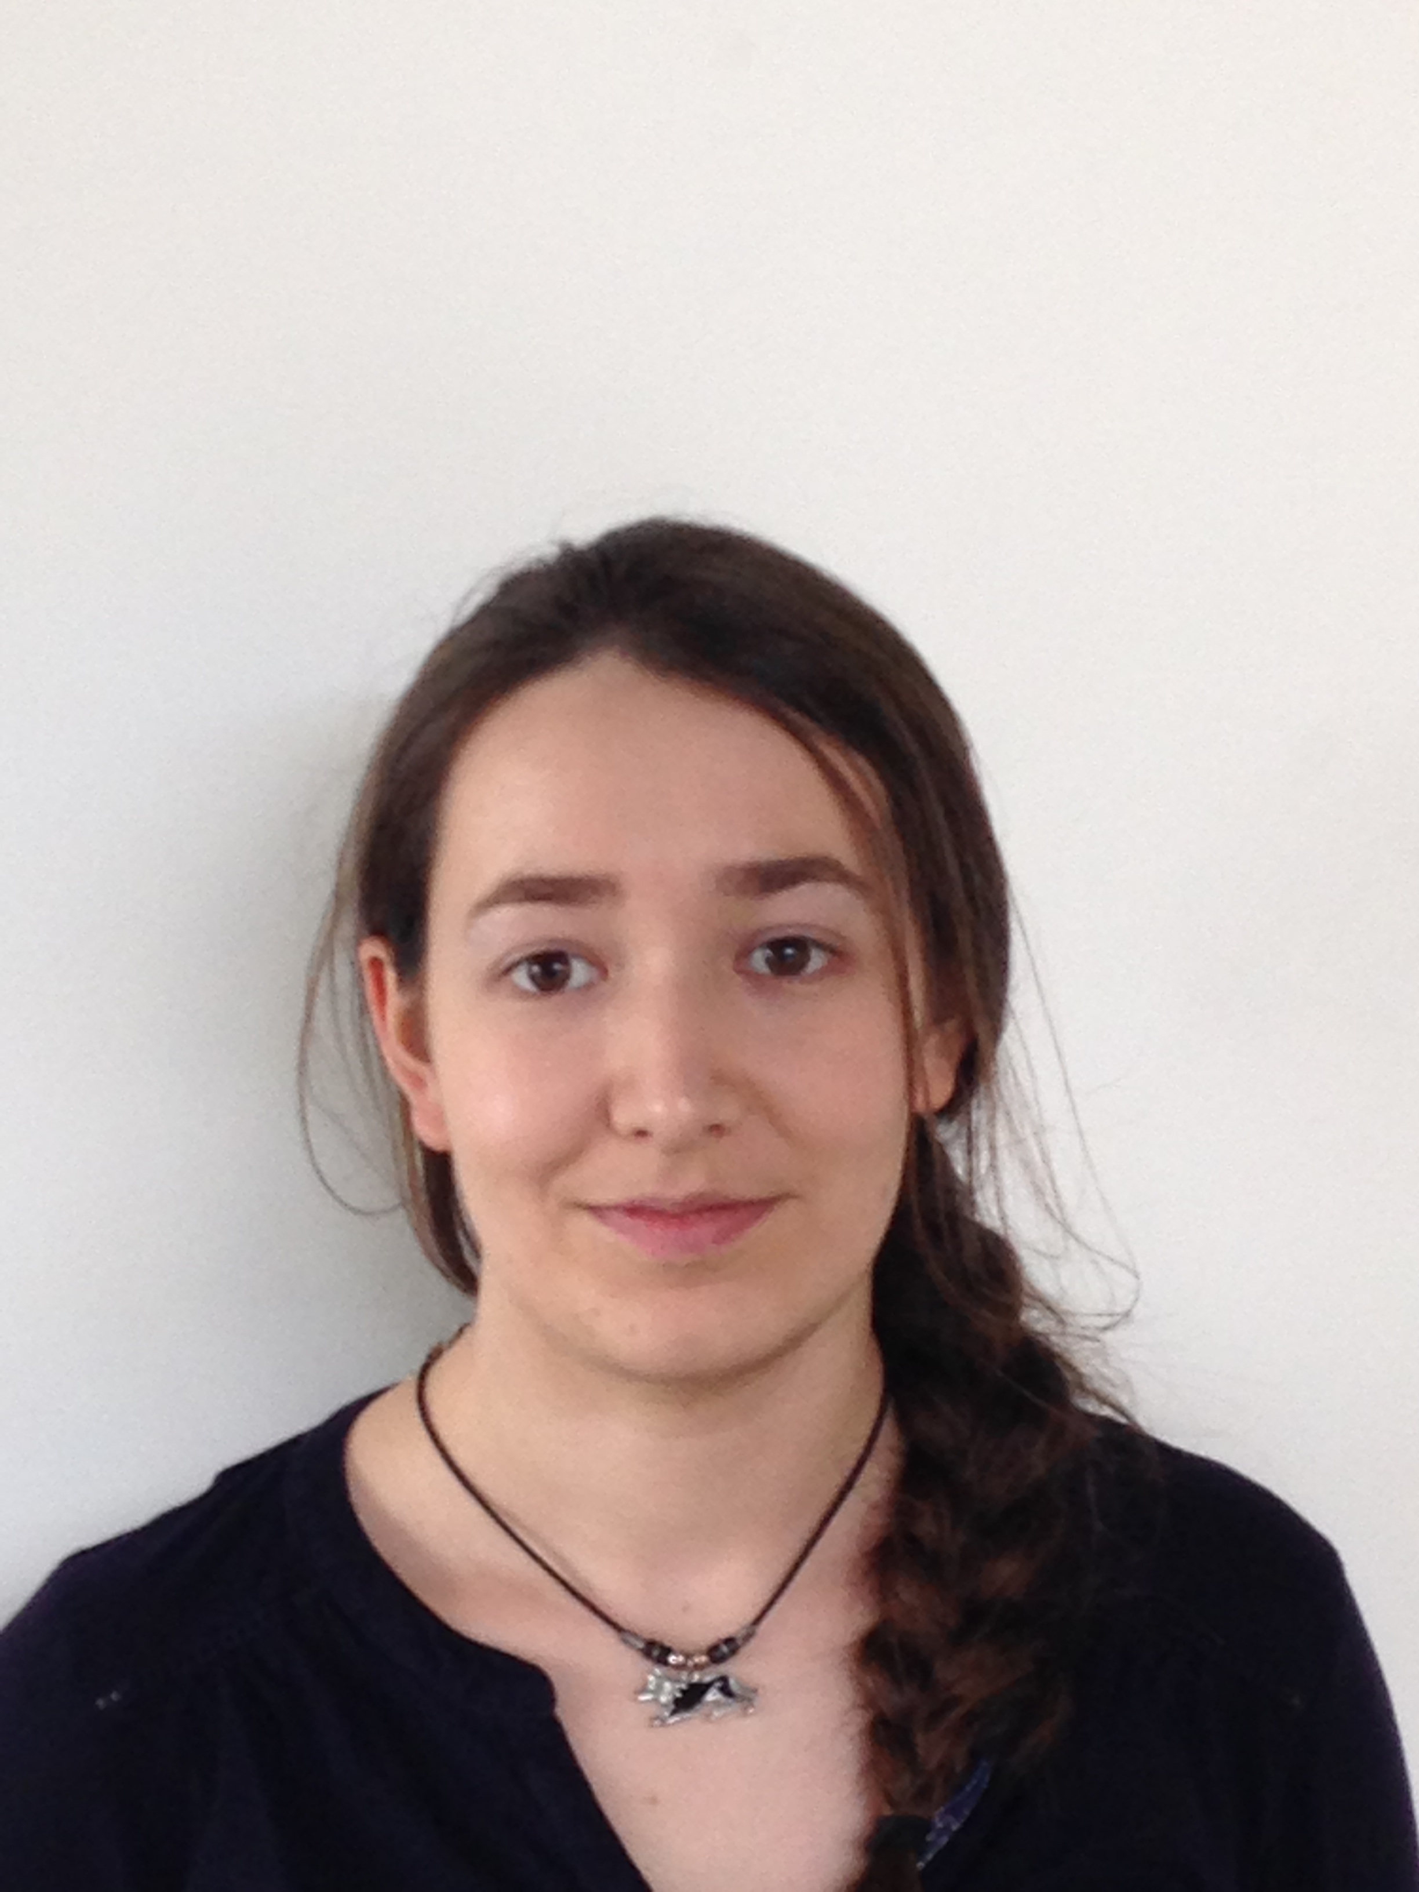

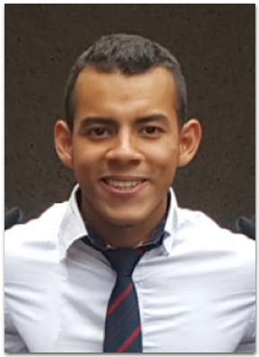
Meet the team
Aurélie
Quintana
JB Blanc--Rouchossé
Claire
Delage
Céline Tomé
Maxime Maurin
Enrique Maldonado

Slide 24
Gantt Chart
Tutorials
Previous work review
Shuttle model
Sensor Update
Pin Update
Setup creation
Update…
…of the GUI
Week
1
2
3
4
5
6

Slide 25
Gantt Chart
Node ‘Robots’
Node ‘Tasks’
Node ‘Track Switches’
Node ‘Shuttles’
Node ‘Scheduling'
Node ‘Station’
Final Integration
Documentation
Week
1
2
3
4
5
6

